Slide 1
Measuring Sustainability Reporting using Web Scraping and Natural Language Processing
Alessandra Sozzi
alessandra.sozzi@ons.gov.uk

Slide 2

Background
In Sept 2015 the United Nations stipulated its requirements for Sustainable Development Goals (SDG’s). The SDGs outline a blueprint for development priorities to be achieved by 2030.
They include 17 goals with 169 targets covering a broad range of sustainable development issues, from ending poverty and hunger to improving health and education, reducing inequality, and combating climate change.
The Office for National Statistics (ONS) has responsibility for reporting the UK’s progress towards the SDGs.

Slide 3
Background
Target 12.6: To encourage companies, especially large and transnational companies, to adopt sustainable practices and to integrate sustainability information into their reporting cycle.
Proposed Indicator: Number of company publishing a sustainability report
Project:
Web scrape companies websites (sample of 100 largest UK private companies)
Extract sustainability-related content
Validation of content extracted using NLP

Slide 4
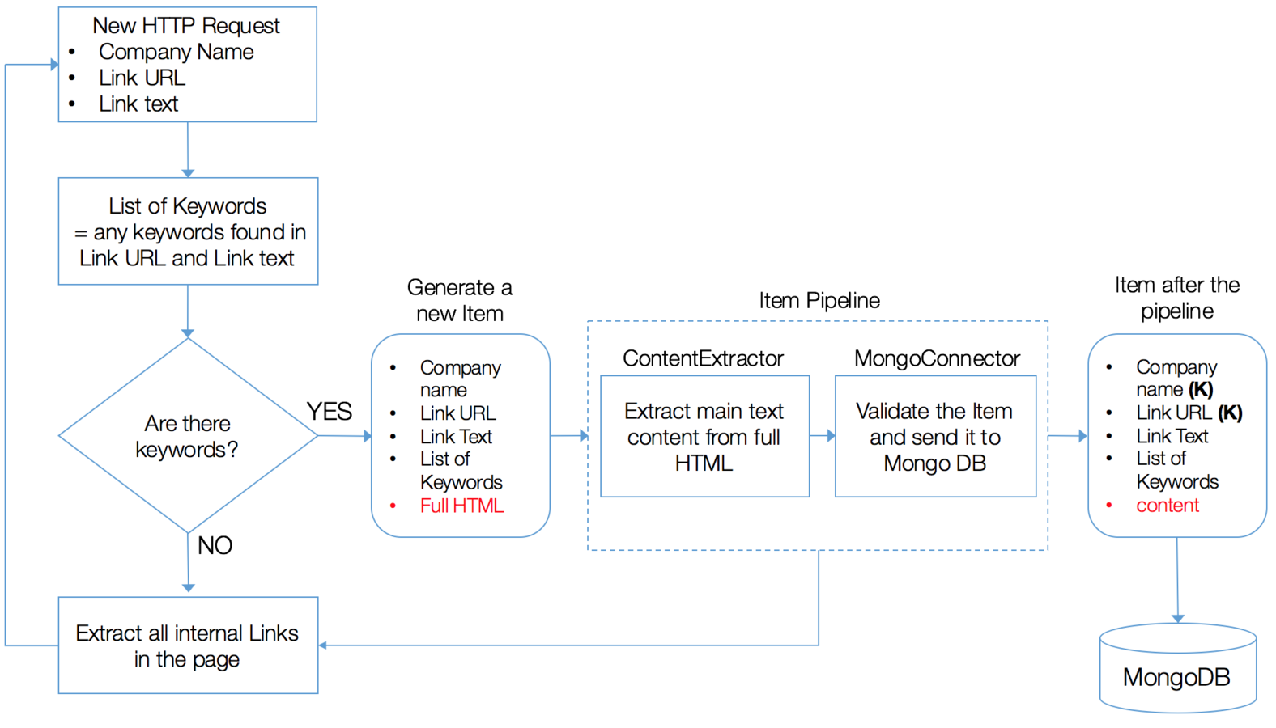
Collecting data from the Web
KEYWORDS: csr, environment, sustainab, responsib, footprint

Slide 5
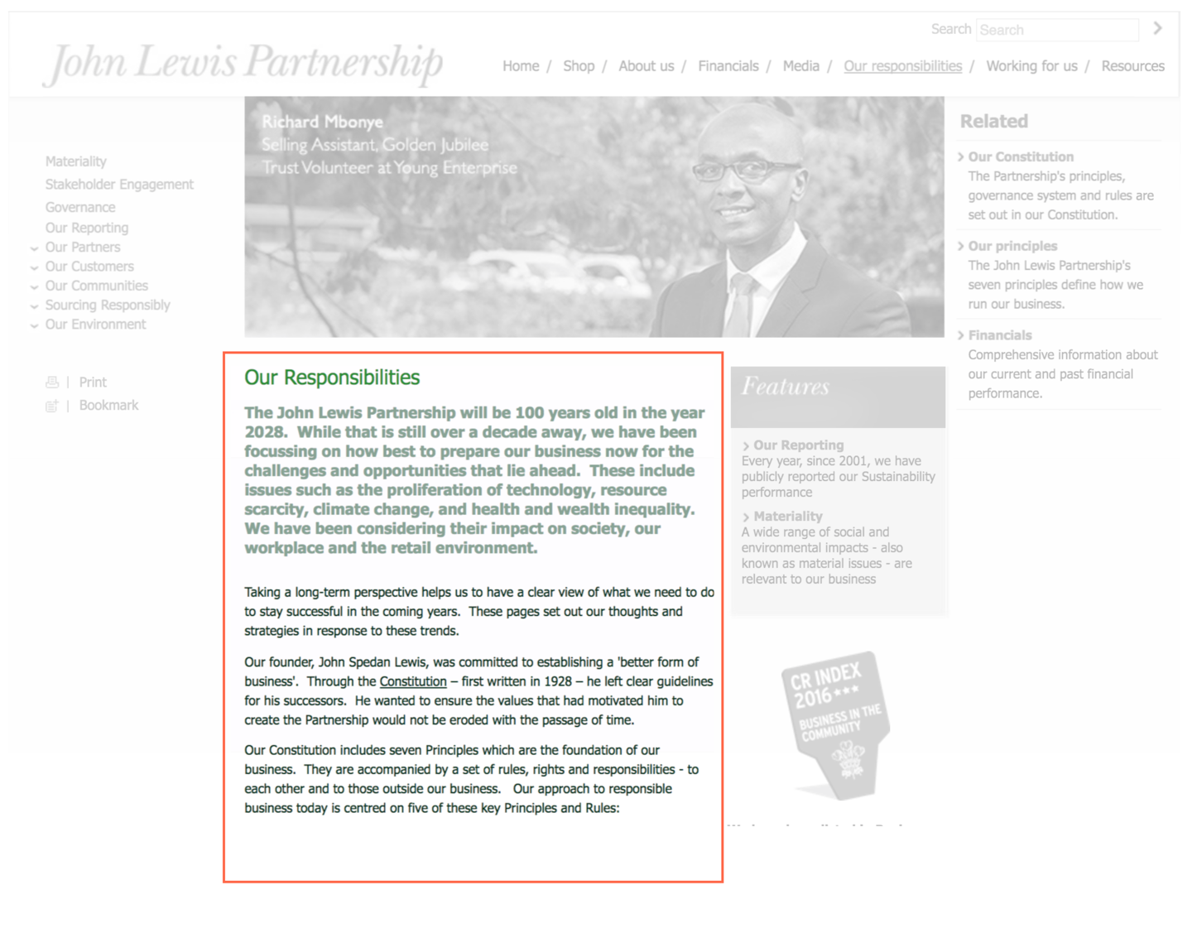
Extracting just the text
Web pages are often cluttered with additional features around the main content. These “features” often include elements such as navigation panels, pop-up ads, advertisements and comments. These noisy parts tend to negatively affect the performances of NLP tasks.
Main content

Slide 6
Extracting just the text
To decide which content extraction algorithm works best for our needs, we performed a test on a sample of 30 URLs. Four methods considered:
Dragnet: uses an ensemble of machine learning models to extract the main article content
Readability: was originally thought as a browser add-on to turn any webpage into a clean view, to give users a better reading experience. This algorithm gives a score to each part of the HTML page based on a series of deterministic rules such as the number of commas, class names, link density and so on.
<p> tags: this method simply extract all text enclosed within <p> tags (<p> … </p> ). This notation is generally used in HTML language to surround textual paragraphs.
BeautifulSoup get_text(): BeautifulSoup is a Python library for parsing HTML files. The get_text() method of this library simply extract all text without making any distinction between good or bad content.

Slide 7
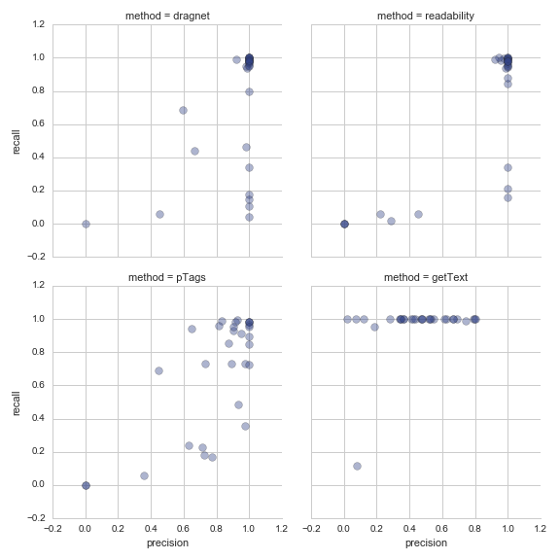
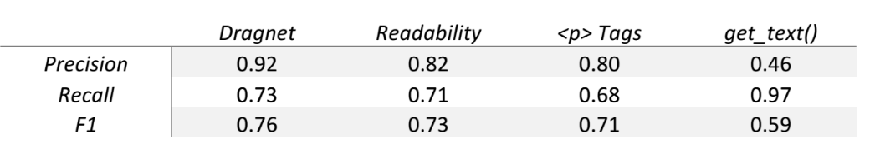
Extracting just the text
Precision: is the percentage of true tokens among all the retrieved tokens by the method. Precision can be seen as a measure of exactness or quality.
Recall: is the percentage of true tokens retrieved by the method among all the true tokens. Recall can be seen as a measure of completeness or quantity.

Slide 8
Collecting data from the Web
Results:
Extracted 563 sustainability-related web pages from 59 companies
35 companies with no sustainability content
6 problematic cases
Observations:
First half: 80% Second Half: 45%
Manufacturer vs Services

Slide 9
Topic Modelling and LDA
Topic models represent a family of computer programs that extract topics from texts. A topic is a list of words that occur in statistically meaningful ways. Topic modelling algorithms do not require any prior annotations or labelling of the documents. Instead, the topics emerge from the analysis of the original texts.
Latent Dirichlet allocation (LDA) produce two results:
Topics as a distribution over words: words that are more meaningful for the topic have a higher probability
Documents as a distribution over topics: documents exhibit multiple topics (but typically not many). This is a distinguishing characteristic of LDA, in contrast with the assumption made by typical mixture models which assumes documents exhibit only a single topic.

Slide 10
Topic Modelling and LDA
Topics

Slide 11
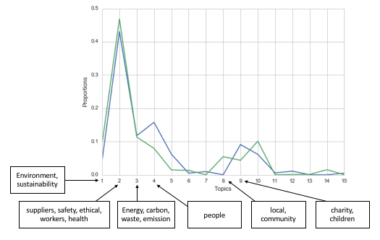
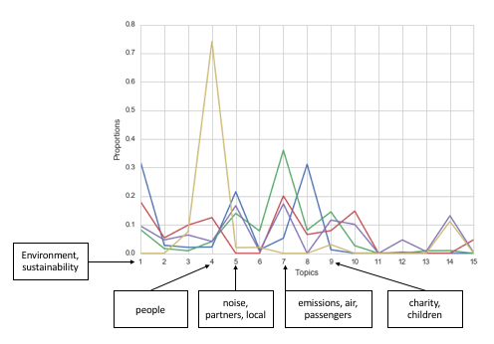
Companies-topic distribution by Industry
Fashion Retailers
Transport industry

Slide 12
Conclusions
Results show it is possible to discern the number of companies publishing sustainability information via scraping of their websites.
Sustainability means different things for different companies.
Effects of industry type and size of the company are worth exploring more, especially when a much larger number of companies will be considered.

